Slide 1

ABAP Language Basics

Slide 2
Origin
ABAP is a programming language developed by SAP for the development of business applications in the SAP environment. ABAP is the fourth-generation programming language and technical module of SAP, which is used to develop the applications related to SAP. With the help of ABAP, one can customize SAP according to the requirement.

Slide 3
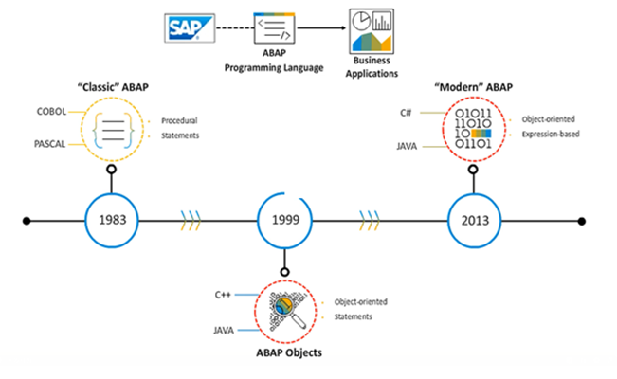
What is ABAP?
Reference: https://learning.sap.com/

Slide 4
Why learn ABAP?
ABAP is the core language used in the SAP R/3 platform.
As a programming language, ABAP is easy to learn that provides both procedural and object-oriented concepts of programming.
It is the main technology that ABAP developers work on to develop various SAP applications.

Slide 5
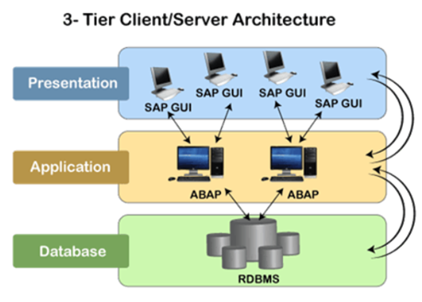
Process of ABAP in SAP Kernel
We can understand the process of ABAP in SAP by using 3 tier architecture of SAP.
Reference: https://www.javatpoint.com/

Slide 6
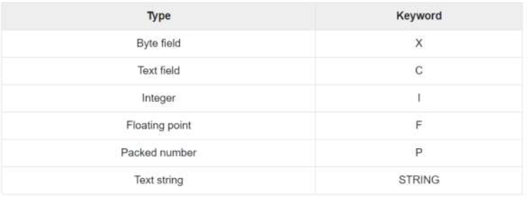
Basic Data Objects & Data Types
Elementary Data Types
ABAP offers the programmer a rich assortment of fixed length as well as variable length data types. Following table lists down ABAP elementary data types –

Slide 7
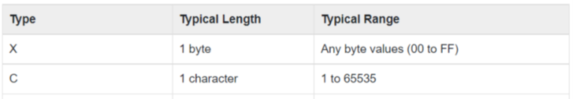
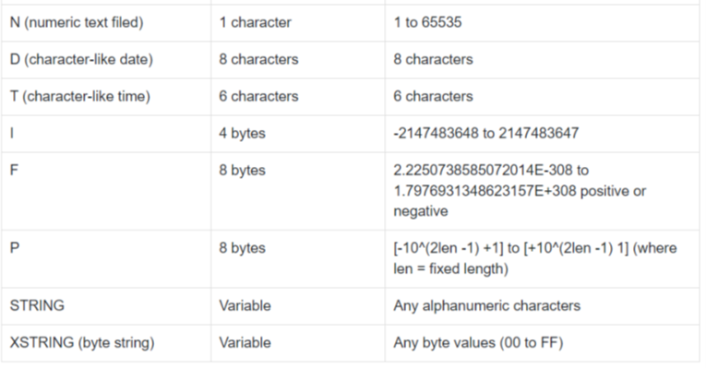
The following table shows the data type, how much memory it takes to store the value in memory, and the minimum and maximum value that could be stored in such type of variables.

Slide 8
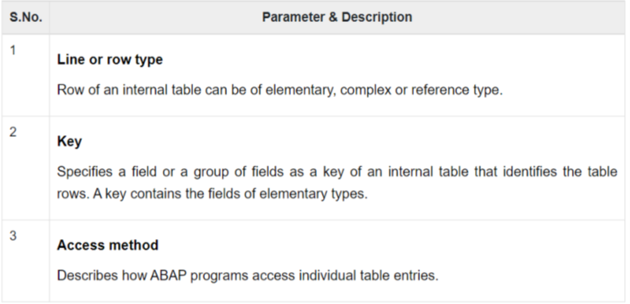
Complex & Reference Types
The complex types are classified into Structure types and Table types. In the structure types, elementary types and structures (i.e. structure embedded in a structure) are grouped together. You may consider only the grouping of elementary types.

Slide 9

Variables
Variables are named data objects used to store values within the allotted memory area of a program.
The basic form of a variable declaration is –

Slide 10
There are three kinds of variables in ABAP -
Static Variables
Reference Variables
System Variables

Slide 11
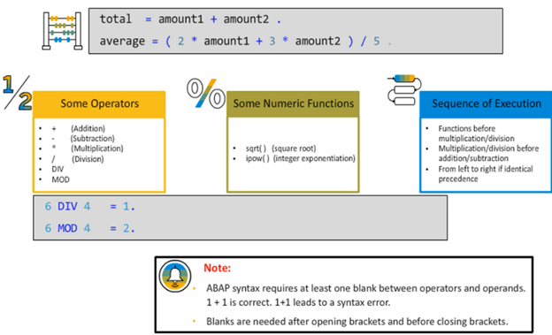
Arithmetic Expressions
Arithmetic expressions are ABAP expressions with a combination of values, operators, and functions that the runtime system processes to calculate a result.
You can use an arithmetic expression in any reading operand position, for example, the right-hand side of a value assignment.

Slide 12
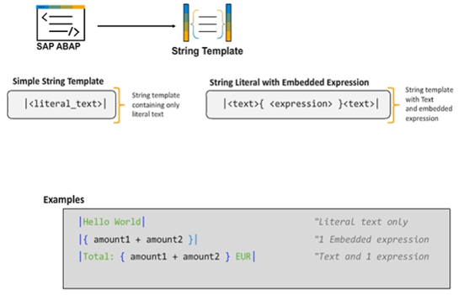
Processing Strings
String templates are ABAP expressions of result type string. You can use string templates in any reading operand position, for example, the right-hand side of a value assignment.

Slide 13
Internal Tables
Defining a Simple Internal Table
Internal Tables
Internal tables are variable data objects in which you can store several values of identical type. This type has to be specified in the declaration and is called the row type of the internal table.

Slide 14
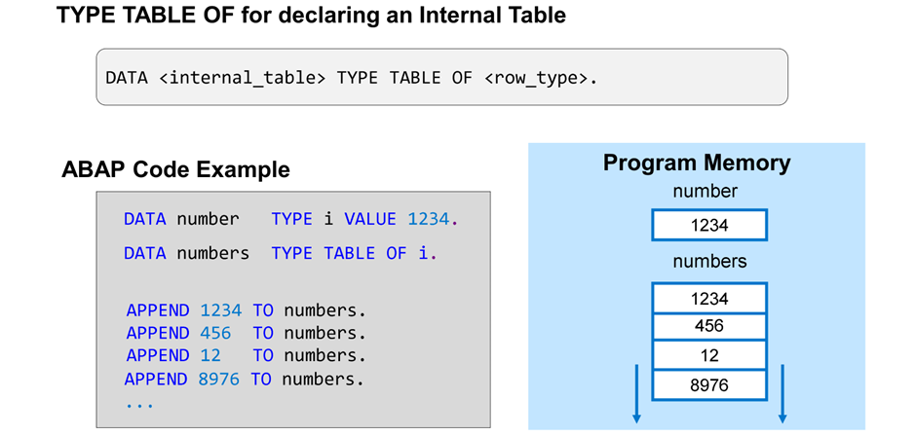

Slide 15
Defining a Local Class
Object
An object is a special kind of variable that has distinct characteristics and behaviors.
An object has the following three main characteristics −
Has a State
Has a unique Identity
May or may not display the behavior

Slide 16
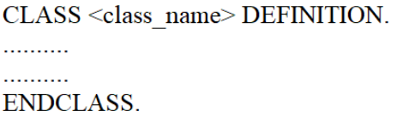
Class
A class is used to specify the form of an object and it combines data representation and methods for manipulating that data into one neat package. The data and functions within a class are called members of the class.
The following syntax shows how to define a class −

Slide 17

Creating an Object
The object creation usually includes the following steps −
Creating a reference variable with reference to the class. The syntax for which is
Creating an object from the reference variable. The syntax for which is –

Slide 18
Defining Methods
Methods of Classes
Methods are internal procedures of a class that determine the behavior of an object.
Different Types of Methods
Instance Methods
Static Methods
Constructors
Functional Methods
Optional Methods

Slide 19
References​
​
https://learning.sap-press.com/abap
https://open.sap.com/courses/mm4h2
https://learning.sap.com/learning-journey/get-started-with-abap-programming-on-sap-btp/understanding-the-basic-features-of-abap_c0e5346f-a136-4b9f-a167-903

